Slide 1

Cooperative development in Rwanda

Slide 2


Overview on cooperative movement
10,072
Cooperative members: 5.2 M
Primary Cooperatives.
10,676
52
%
43%
437
Cooperatives in
SACCOs
Male
Female
Rwanda
152
Unions.
Share capital collected
15
Federations.
52.7 bn Rwf

Slide 3
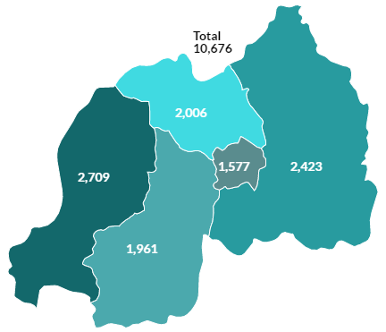
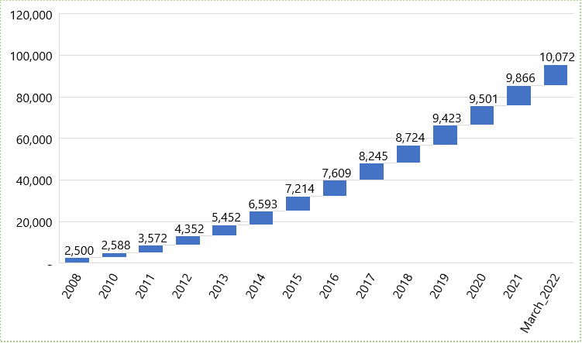
Cooperatives formation and registration

Slide 4
Economic sector | No. of coops. | % | Membership |  |  | % | Share Capital (Rwf)
 |  |  | Male | Female | Total
Agriculture | 4,936 | 46 | 641,826 | 502,510 | 1,144,336 | 22 | 10,383,830,577
Trading | 1,561 | 15 | 120,852 | 141,162 | 262,014 | 5 | 9,588,130,208
Services | 1,778 | 17 | 137,083 | 125,930 | 263,013 | 5 | 4,554,503,076
Handicraft | 1,170 | 11 | 27,210 | 64,971 | 92,181 | 2 | 2,131,209,430
Transformation | 187 | 2 | 17,588 | 11,827 | 29,415 | 1 | 1,051,720,308
Mining | 130 | 1 | 60,849 | 46,819 | 107,668 | 2 | 671,486,100
Housing | 221 | 2 | 30,517 | 18,598 | 49,115 | 1 | 5,327,773,338
Other sectors | 89 | 1 | 61,965 | 49,558 | 111,523 | 2 | 523,372,022
Subtotal | 10,072 | 94 | 1,097,890 | 961,375 | 2,059,265 | 39 | 34,232,025,059
SACCOs | 437 | 4 | 1640736 | 1298790 | 3219670 | 61 | 18218682753
Unions | 152 | 1 | - | - | - | - | 214416675
Federations | 15 | 0 | - | - | - | - | 61020000
Grand Total | 10,676 | 100 | 2,738,626 | 2,260,165 | 5,278,935 | 100 | 52,726,144,487

Slide 5
Priority |  | Implementation
Economic Transformation
Create 1,500,000 (214,000 annually) decent and productive jobs. | 2,282 new cooperatives created with an increase of 26.5%. 126,762 people joined together to work through cooperatives. In general, on average each cooperative has at least 3 employees and provide many jobs to casual workers. Cooperatives provides job opportunities to members. | 2,282 new cooperatives created with an increase of 26.5%. 126,762 people joined together to work through cooperatives. In general, on average each cooperative has at least 3 employees and provide many jobs to casual workers. Cooperatives provides job opportunities to members.
Accelerate sustainable urbanization from 18.4% (2016/17) to 35% by 2024. | 42 housing cooperatives were formed with 1,974 members.
Increase domestic savings and position Rwanda as a hub for financial services to promote investments | Savings: 25,481,295,149 frw Its mandatory for a cooperative to save 10% of its profit (new cooperative law) Cooperatives save through Ejo Heza for their members.
Modernize and increase the productivity of agriculture and livestock. | Agricultural cooperatives increased by 26% from 2017 to March 2022.
Promote sustainable management of the environment and natural resources to transition Rwanda towards a Green Economy. | 6 environmental cooperatives were created.

Slide 6
Implementation of key priorities of NST1
Priority | Implementation
Social Transformation
Eradicate Malnutrition through enhanced prevention and management of all forms of malnutrition. | Agricultural cooperatives increased by 26% to ensure food security and malnutrition reduction.
Enhance the Demographic Dividend through ensuring access to quality health for all. Focus will be on improving health care services at all levels, strengthening financial sustainability of the health sector, and enhancing capacity of health workforce. | Most of the cooperatives provide medical insurance for their members. Abajyanama b’ubuzima supported
Transformational Governance
Strengthen Justice, Law and Order. | New cooperative policy established New cooperative law adopted. 312 cooperatives audited and more than 4 thousand cooperatives inspected. Different instructions were developed.
Increase Citizens’ Participation and Engagement in Development. | Cooperatives are democratic member control where a member has one vote and all votes are equal. Gender equality: male: 52% and female: 43%.

Slide 7
Thank you

